Slide 1
Predicting Air Quality in Milan
blurb
Dan Herweg
May 2019

Slide 2
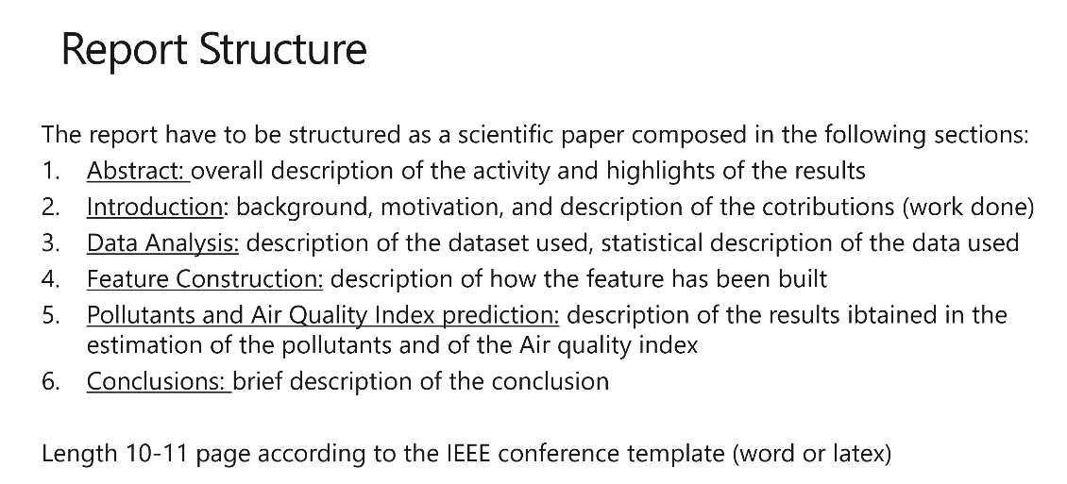
Contents
Summary
Background
Motivation and Contribution
Methodology
Data
Feature Construction
Data Exploration
Model
Pollutants and Air Quality Index Prediction
Conclusion

Slide 3
Summary sentence Summary
A summary of results
Pursuing hypothesis that it will work
This deck is a brief documentation of the project

Slide 4
I WAS FORCED TO DO THIS Motivation
Adff

Slide 5
I kept typing until it worked Methodology
Here I examine whether a CNN can look at a stock price pattern for the past 90 trading and decide which direction trading will go over the next month (20 trading days)
While strong predictive results would be welcome, this project was driven by both curiosity and a desire to work with images and neural networks on public data
Picture: https://www.123rf.com/photo_20237672_turtle-on-money.html

Slide 6
The data is cool and good Data Analysis - Univariate
asdf
Picture: https://www.123rf.com/photo_20237672_turtle-on-money.html

Slide 7
The data is cool and good Data Analysis - Multivariate
asdf
Picture: https://www.123rf.com/photo_20237672_turtle-on-money.html

Slide 8
The model is nice Modelling Results – Single Linear Regression
asdf
Picture: https://www.123rf.com/photo_20237672_turtle-on-money.html

Slide 9
The model is nice Modelling Results – Multiple Linear Regression
asdf
Picture: https://www.123rf.com/photo_20237672_turtle-on-money.html

Slide 10
The model is nice Modelling Results – Model Evaluation
asdf
Picture: https://www.123rf.com/photo_20237672_turtle-on-money.html

Slide 11
Resources
Deep lizard
Whatever architecture I use
Any significant links from code
Picture: https://www.123rf.com/photo_20237672_turtle-on-money.html

